Slide 1

PROGRAMMING FUNDAMENTALS
FALL 2023

Slide 2

WEEK 2
HOW PROGRAM RUNS
HOW TO APPROACH PROBLEMS

Slide 3
semester system
credit hours/ grades
LEC 1
warnings
concept of pre req
intro to degree
intro of students
intro to course
importance of course
Already done !
marks distribution
class rules

Slide 4
COVERED IN LAST WEEK
how to communicate with computer
Programming Language
LEC 2
google class room code
C,C++,java, PHP, python, ruby, java script, C#
course content
intro of teacher
Classification of programming languages
tentative course outline
high level : easy to understand by human
course books
mid level: symbolic languages -> assembly language
Class Policy & Etiquette
low level language :machine level -> binary -> 01
CLO's
e.g. if(age>17)
computer hardware
Already done !
switches on/ off
in high level , how it is in middle level and how it is in low level
transistor , IC's
Source file.

Slide 5
WEEK 1 : HOME ACTIVITY
HOPEFULLY DONE , COVERED IN LAST WEEK
MAKE SURE YOU JOINED GCR !
Already done !

Slide 6
THINGS TO UNDERSTAND FROM IICT LAB
What is computer
What is hardware
What is software
Input
Processing
Output
Storage - > bit -> byte
OS

Slide 7
To write a program for a computer, we must use a computer language.
Computer language is a way to talk or instruct a computer.
Already done !

Slide 8
COMPUTER PROGRAM
A computer program is a set of instructions written using a Computer Programming Language to perform a specified task by the computer.

Slide 9
BUILDING A C PROGRAM
writing and editing the program
compiling the program
linking the program with the required library modules
executing the program.

Slide 10
BUILDING A C PROGRAM
RAM and Storage
Compiler
Interpreter
Editor
Linker
Library
Loader

Slide 11
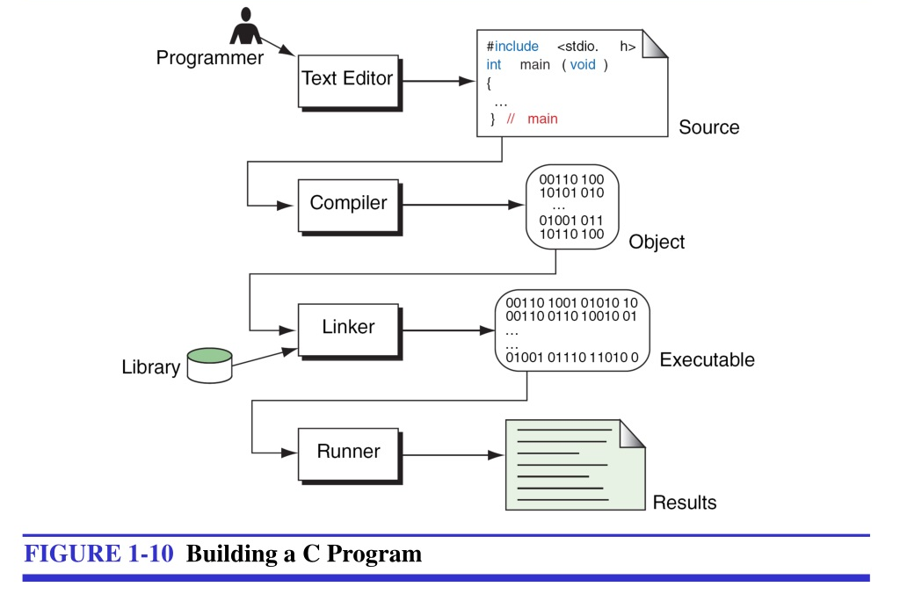

Slide 12
EDITOR :The software used to write programs is known as editor.
SOURCE FILE :After we complete a program, we save our file to disk. This file will be input to the compiler; it is known as a source file and has extension “.c” in case of C language.
COMPILER : The code in a source file stored on the disk must he translated into machine language. This is the job of the compiler.
LINKER : Linker helps to link library functions with the file generated by compiler.
LOADER : Loader puts the program into RAM for execution.

Slide 13
Program Development is a multistep process that requires that we
under- stand the problem, develop a solution, write the program, and test it.

Slide 14
READ YOUR SELF , NO NEED TO MEMORIZE
Why Learn C Programming?
Why learn how to program in C? Learning C can actually make it easier to learn and fully understand other programming languages like C++, Java, or Python.
It gives you a solid understanding of how programming languages work since it is a base-level language that’s closer to the machine.
The C language syntax teaches you how to write efficient and fast code, so it could even be a good first programming language providing a foundation to build on.

Slide 15
WEEK 2 (LEC 4)

Slide 16
APPROACHING A PROBLEM AND ITS SOLUTION
Open editor and start writing code ? Is it a Good approach ?
Writing correct instruction is very important for computer.
It does what we say.

Slide 17
APPROACHING A PROBLEM AND ITS SOLUTION
Example : If you are supposed to run a service like BRT ?
Or you have to cook an egg or omelet….

Slide 18
APPROACHING A PROBLEM AND ITS SOLUTION
Writing correct instruction is very important for computer.
It does what we say , Lets understand importance of instructions from this video.
https://www.youtube.com/watch?v=Ct-lOOUqmyY

Slide 19
ALGORITHM
An algorithm is a finite step-by-step process for solving a problem. It can be as simple as a recipe to bake a cake, or as complicated as the process to implement an autopilot system for a 747 jumbo jet.
Algorithms generally start off with a problem statement. It is this problem statement that programmers use to formulate the process for solving the problem. Keep in mind that the process of building algorithms and algorithm analysis occurs before any program code has been written.

Slide 20
AN ALGORITHM REPRESENTED IN
form of symbols / figures is called flow chart.
form of simple terms and mathematical terms is called pseudocode
form of programming language is called computer program.

Slide 21
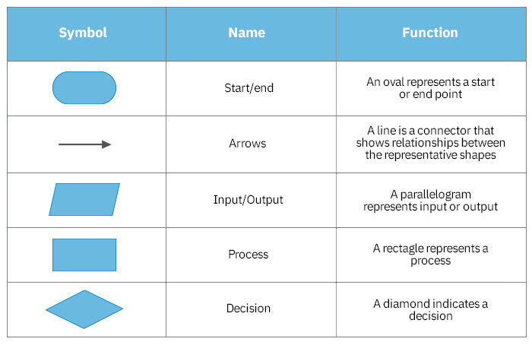

Slide 22
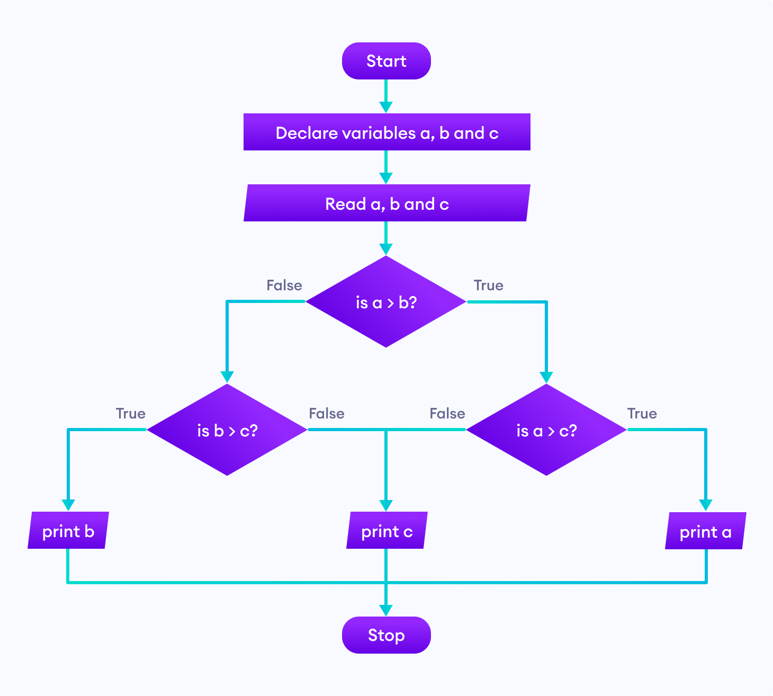
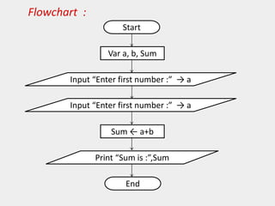
Should be in multiple steps
Flaw here
Wrong symbol

Slide 23
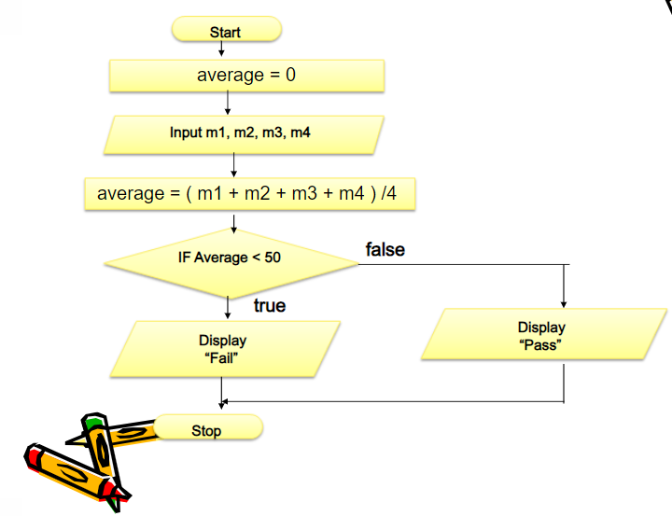
PROBLEM
Enter marks of 4 subjects and find average. If average is less than 50 display fail else display pass.

Slide 24
PSEUDOCODE
Pseudo means false
It is a simpler version of a programming code in plain English which uses short phrases to write code for a program before it is implemented in a specific programming language.

Slide 25
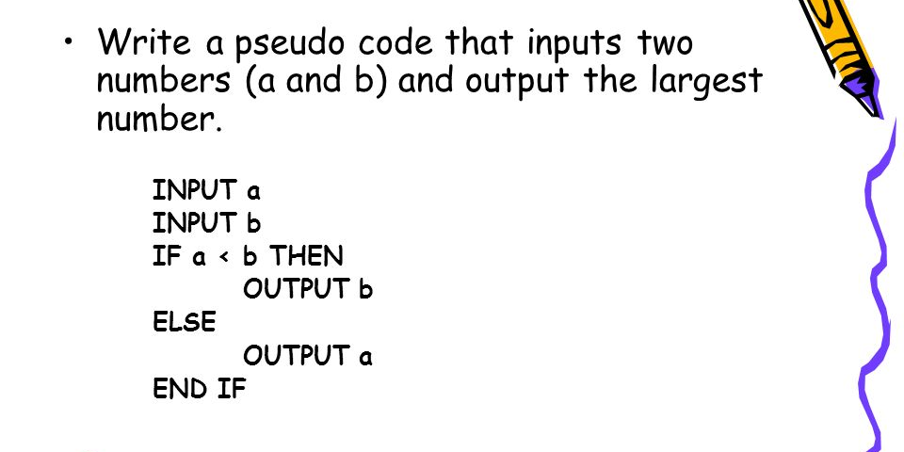

Slide 26



THANK YOU

